Slide 1
Introduction to Computer Networks CS156
Reference models
Lecture -3-4 (Theory)
Dr. Htet Ne Oo
Department of Computer Science and Engineering,
Chitkara University, Punjab

Slide 2
Index
,
Reference model
Seven-Layers of OSI
Concept of Layers
Protocols
Protocol Data Unit (PDU)

Slide 3
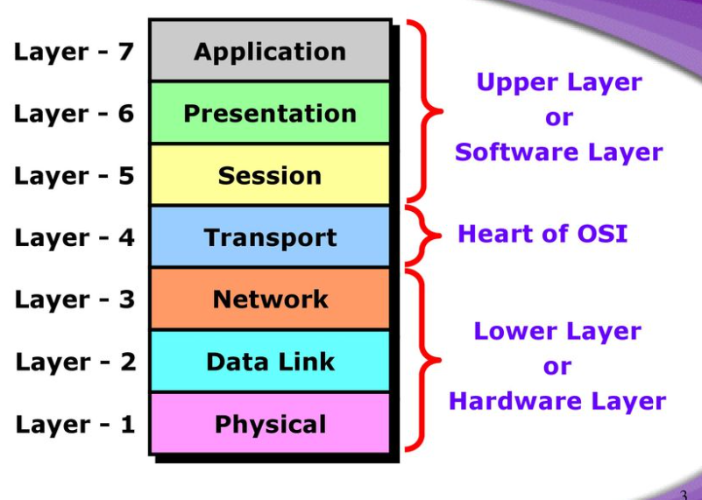
Index
Figure 1 :OSI Reference Model

Slide 4
OSI Reference Model
OSI Reference Model - internationally standardised network architecture.
OSI = Open Systems Interconnection: deals with open systems, i.e. systems open for communications with other systems.
Specified in ISO 7498.
Model has 7 layers.
Notes:
The OSI model describes the flow of data in a network, from the lowest layer (the physical connections) up to the layer containing the user’s applications. Data going to and from the network is passed layer to layer. Each layer is able to communicate with the layer immediately above it and the layer immediately below it. This way, each layer is written as an efficient, streamlined software component. When a layer receives a packet of information, it checks the destination address, and if its own address is not there, it passes the packet to the next layer.
When two computers communicate on a network, the software at each layer on one computer assumes it is communicating with the same layer on the other computer. For example, the Transport layer of one computer communicates with the Transport layer on the other computer. The Transport layer on the first computer has no regard for how the communication actually passes through the lower layers of the first computer, across the physical media, and then up through the lower layers of the second computer.

Slide 5
7-Layer OSI Model
Layer 7
Application Layer
Layers 1-4 relate to communications technology.
Layers 5-7 relate to user applications.
Layer 6
Presentation Layer
Layer 5
Session Layer
Layer 4
Transport Layer
Layer 3
Network Layer
Layer 2
Data Link Layer
Layer 1
Physical Layer
Communications subnet boundary
Notes:
The Application layer represents the level at which applications access network services. This layer represents the services that directly support applications such as software for file transfers, database access, and electronic mail.
∙ The Presentation layer translates data from the Application layer into an intermediary format. This layer also manages security issues by providing services such as data encryption, and compresses data so that fewer bits need to be transferred on the network.
∙ The Session layer allows two applications on different computers to establish, use, and end a session. This layer establishes dialog control between the two computers in a session, regulating which side transmits, plus when and how long it transmits.
∙ The Transport layer handles error recognition and recovery. It also repackages long messages when necessary into small packets for transmission and, at the receiving end, rebuilds packets into the original message. The receiving Transport layer also sends receipt acknowledgments.
∙ The Network layer addresses messages and translates logical addresses and names into physical addresses. It also determines the route from the source to the destination computer and manages traffic problems, such as switching, routing, and controlling the congestion of data packets.
∙ The Data Link layer packages raw bits from the Physical layer into frames (logical, structured packets for data). This layer is responsible for transferring frames from one computer to another, without errors. After sending a frame, it waits for an acknowledgment from the receiving computer.
∙ The Physical layer transmits bits from one computer to another and regulates the transmission of a stream of bits over a physical medium. This layer defines how the cable is attached to the network adapter and what transmission technique is used to send data over the cable
This partition into ‘lower’ and ‘upper’ layers is a widely used way to distinguish between the communications-oriented layers and the applications- oriented layers.
In fact layers 5 and 6 are often ignored in practical applications (the Internet protocol hierarchy has no equivalents to layers 5 and 6).

Slide 6

Reference model (OSI)
OSI: Open System Interconnect
Established in 1947, the International Standards Organization (ISO) is a multinational body dedicated to worldwide agreement on international standards. An ISO standard that covers all aspects of network communications is the Open Systems Interconnection (OSI) model. It was first introduced in the late 1970s.

Slide 7
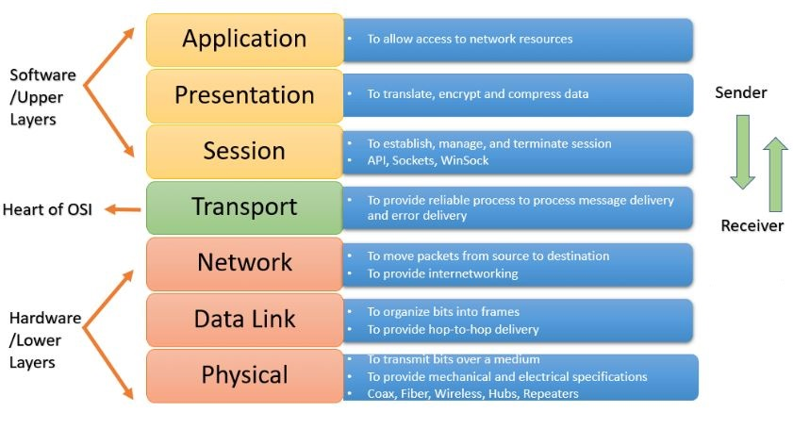
Layers of OSI model

Slide 8
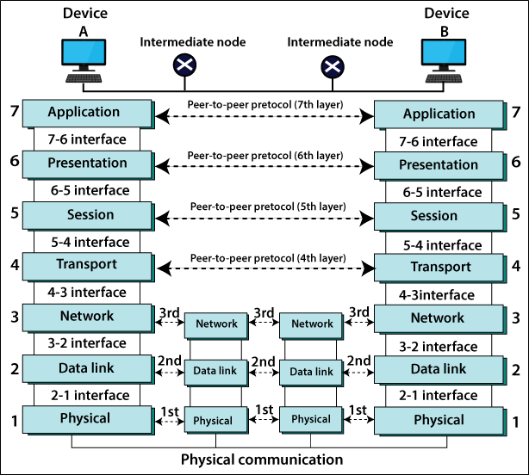
Interaction between layers in OSI model

Slide 9
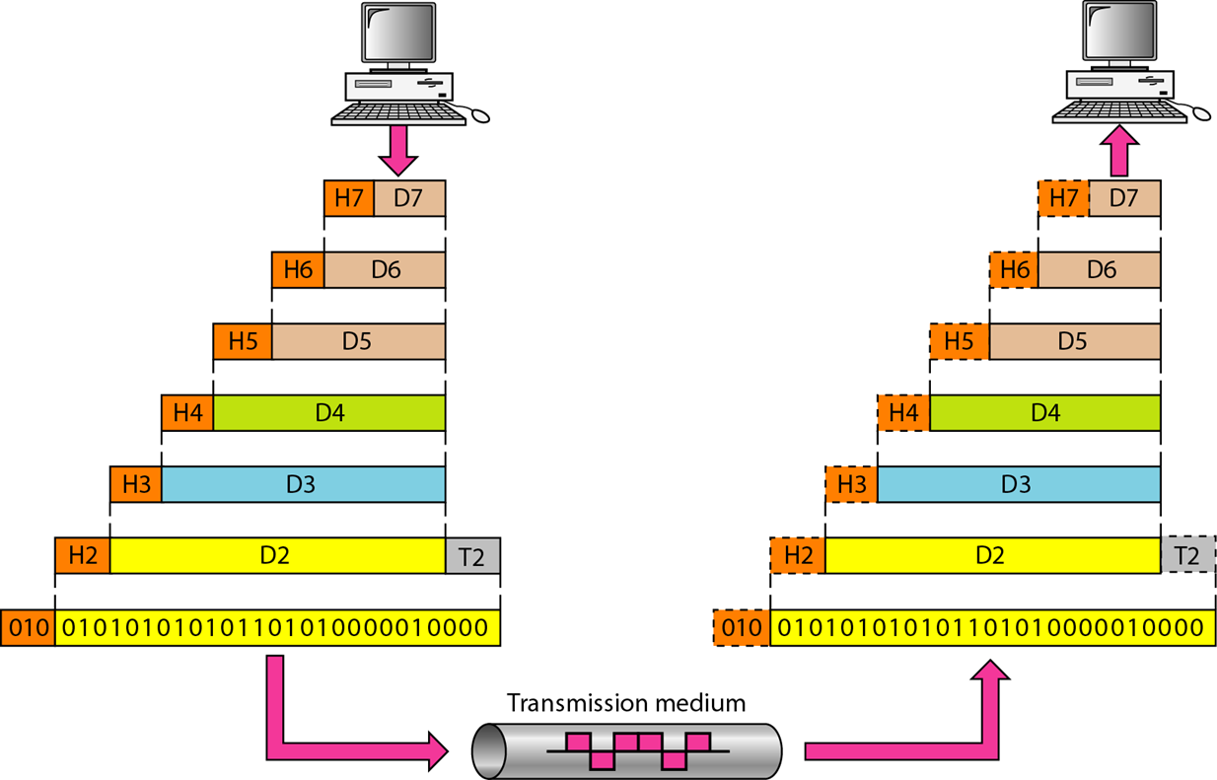
An exchange using the OSI model

Slide 10
Layers in the OSI model
In this section we briefly describe the functions of each layer in the OSI model.
Physical Layer
Data Link Layer
Network Layer
Transport Layer
Session Layer
Presentation Layer
Application Layer

Slide 11
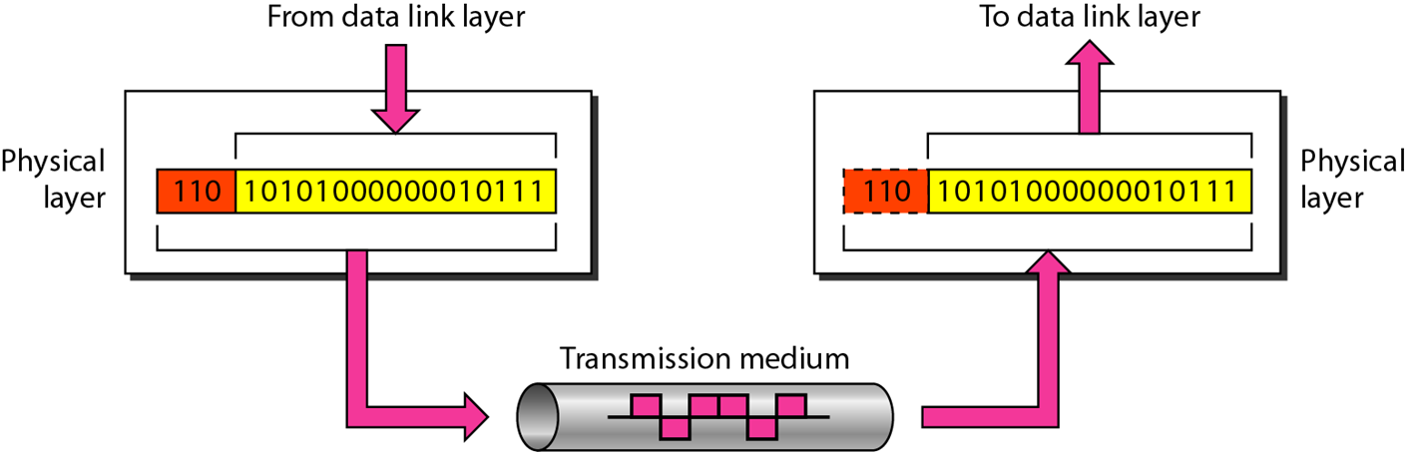

1. Physical Layer
Note
The physical layer is responsible for movements of individual bits from one hop (node) to the next.

Slide 12
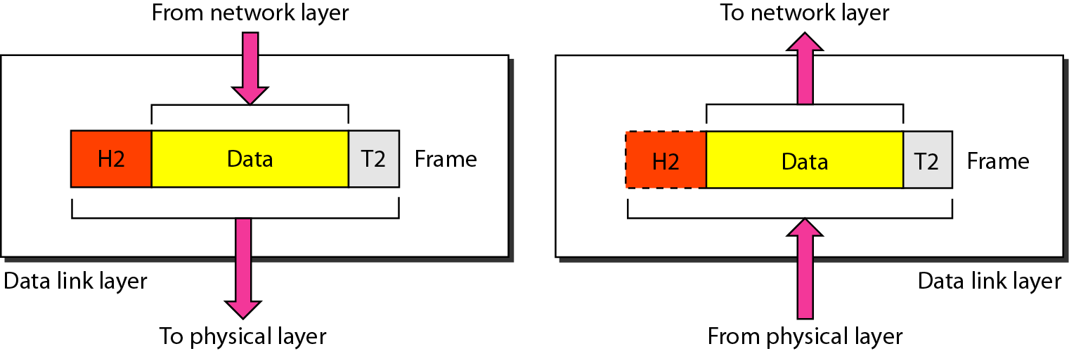
2. Data link layer
Note
The data link layer is responsible for moving frames from one hop (node) to the next.

Slide 13
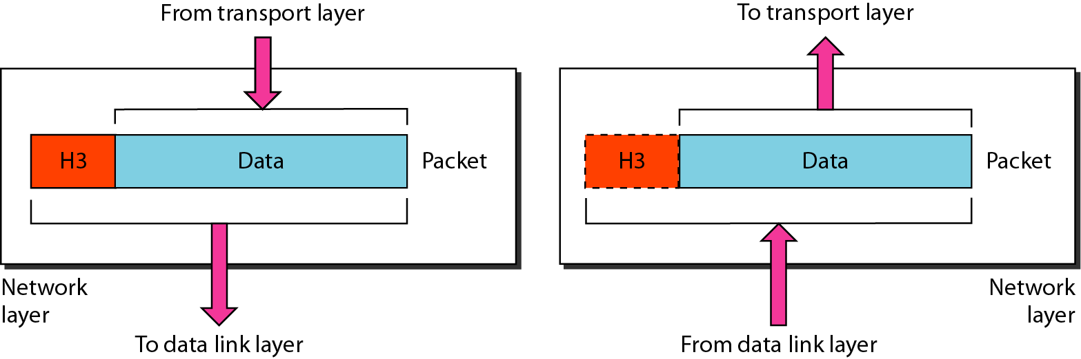
3. Network layer
Note
The network layer is responsible for the delivery of individual packets from the source host to the destination host.

Slide 14
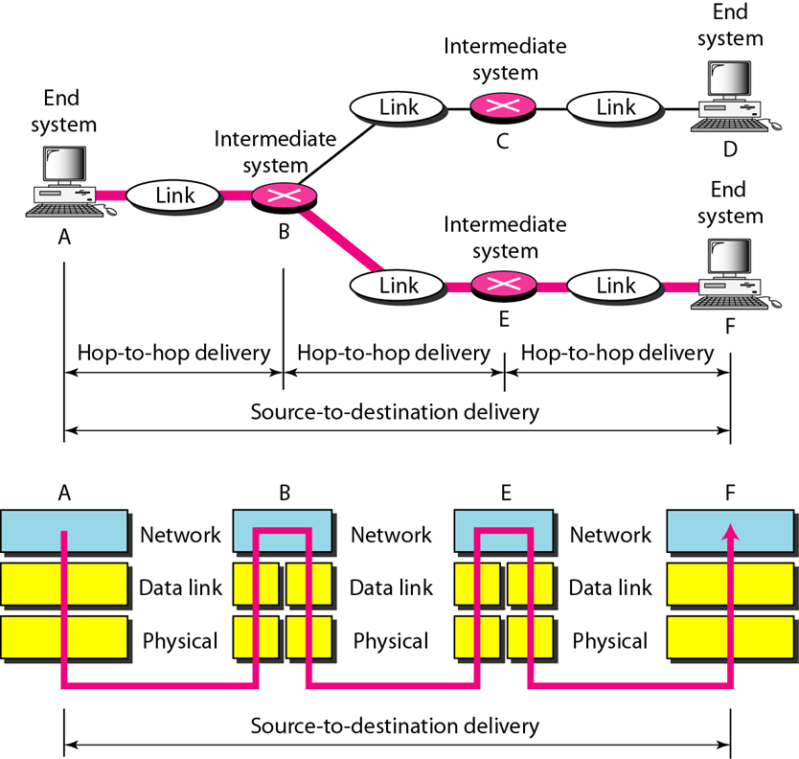
Source to destination delivery

Slide 15
4. Transport Layer
Manages transmission packets
Repackages long messages when necessary into small packets for transmission
Reassembles packets in correct order to get the original message.
Handles error recognition and recovery.
Transport layer at receiving acknowledges packet delivery.
Resends missing packets
Transport Layer is responsible for end-to-end connectivity. It is also known as the heart of OSI Layers. Following tasks are performed at the Transport Layer : -
Identifying Service
Multiplexing & De-multiplexing
Segmentation
Sequencing & Reassembling
Error Correction
Flow Control
Transport
Notes:
The basic function of the Transport Layer is to take data from the Session Layer (Layer 5), split it up into smaller units (as necessary), and pass these units on to the Network Layer. It is then also responsible for ensuring that all the pieces are received correctly and reassembled in the correct order.
Typically the Transport Layer will create a distinct Network Layer connection for each Transport connection requested by the Session Layer. However, depending on the data load and the capacity of a single Session channel:
multiple Network connections might be used to support a single high-bandwidth Session connection, or
one high-bandwidth Network connection might be used to support several Session connections.
The Transport Layer also determines what Type of Service to provide to the Session Layer and, ultimately, to the network users. For example:
an error-free, point-to-point channel, guaranteeing data is delivered in the correct order (the most common type of service),
transport of isolated messages with no guarantee of correct ordering, or
message broadcast to multiple destinations
Transport is the first true end-to-end layer, i.e. the Transport protocol communicates between end parties and not to any of the intermediaries.

Slide 16
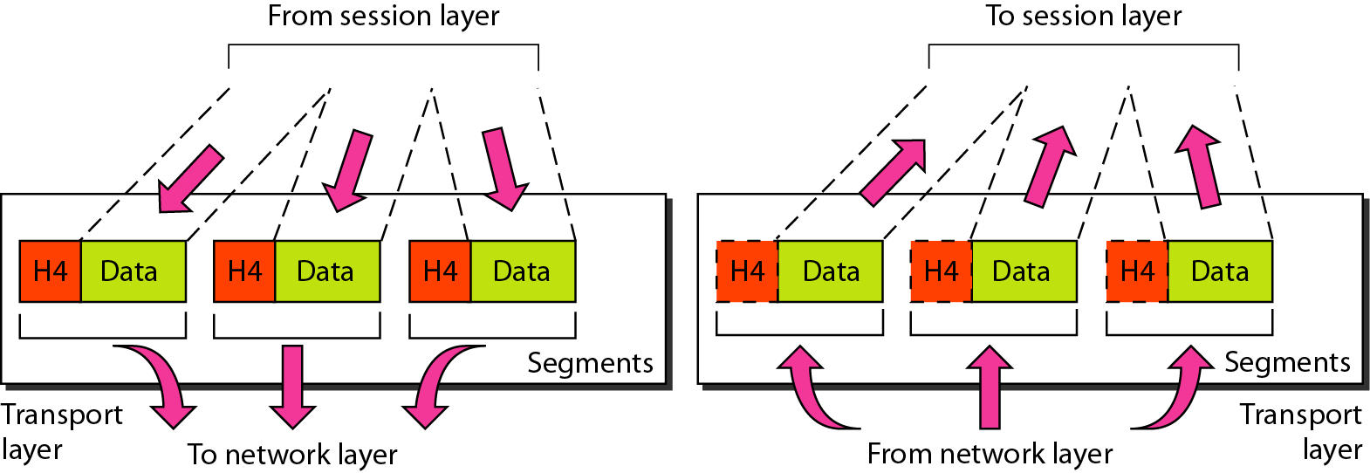
Transport layer
Note
The transport layer is responsible for the delivery of a message from one process to another.

Slide 17
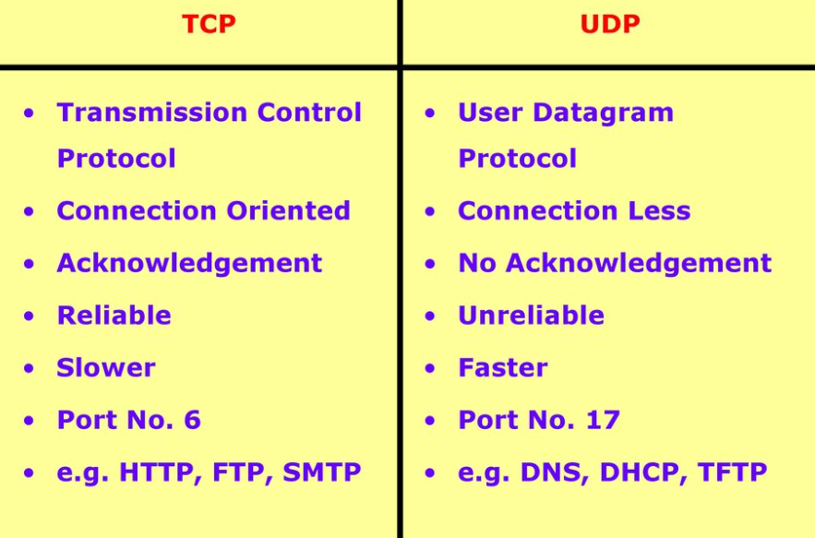
Identify Service
Figure : TCP Vs UDP

Slide 18
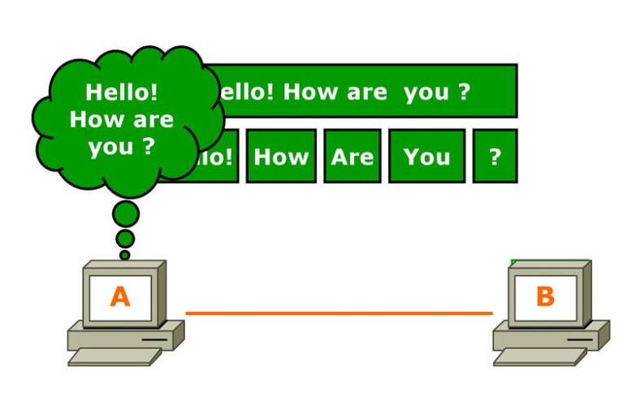
Segmentation
Figure : Segmentation

Slide 19
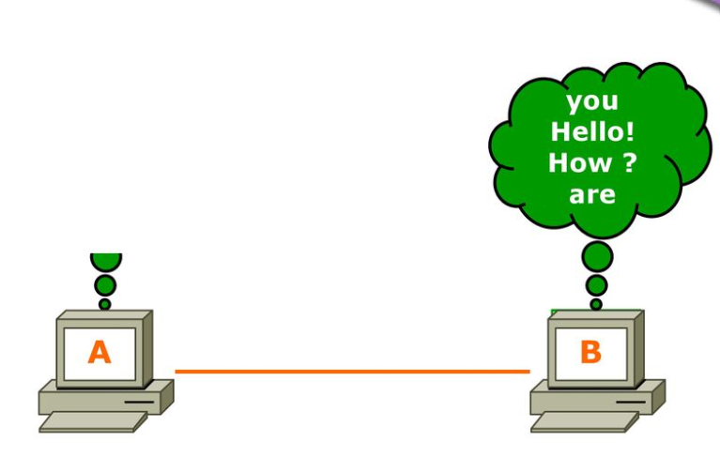
Sequence & Reassembling
Figure : Sequence & Reassembly

Slide 20
5. Session Layer
Allows two applications on different computers to establish, use, and end a session.
e.g. file transfer, remote login
Establishes dialog control
Regulates which side transmits, plus when and how long it transmits.
Performs token management and synchronization.
Session Layer is responsible for establishing, maintaining and terminating session. Session ID works at Session Layer.
Examples :
RPC - Remote Procedure Call
SQL - Structured Query Language
NFS - Network File System
Notes:
The Session Layer allows the establishment of sessions between machines, e.g. to allow remote logins to a multi-user system, or to perform file transfer between machines.
One of the Session services is dialogue control; if the communications are half-duplex then the session layer can manage which entity sends when.
A related service is token management. In some protocols it is essential that both entities do not attempt the same operation simultaneously. Possession of a token permits the operation.
The other main Session service is synchronization. As an example consider attempting a 2-hour file transfer between machines which crash on average once an hour. The synchronization service provides a means for checkpoints to be inserted into the data stream so that, after a crash, only data sent since the last checkpoint needs to be re-transmitted.

Slide 21
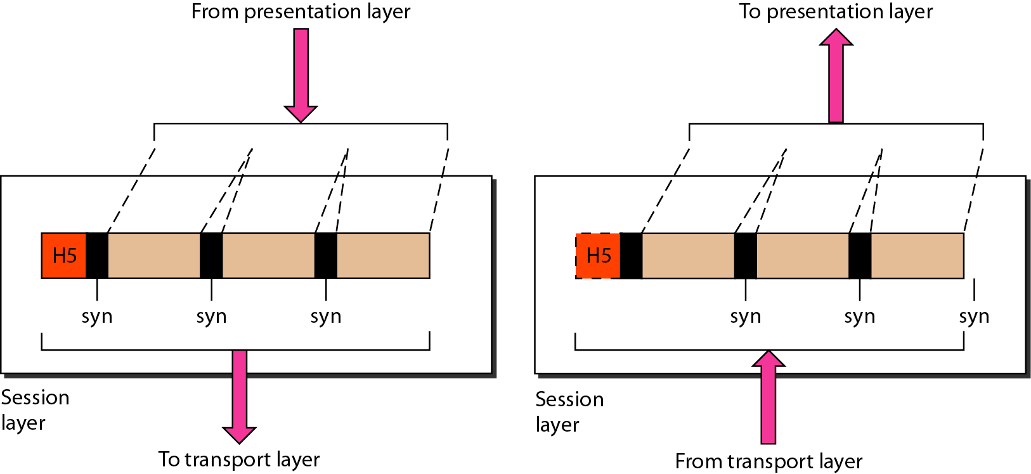
Session layer
Note
The session layer is responsible for dialog control and synchronization.

Slide 22
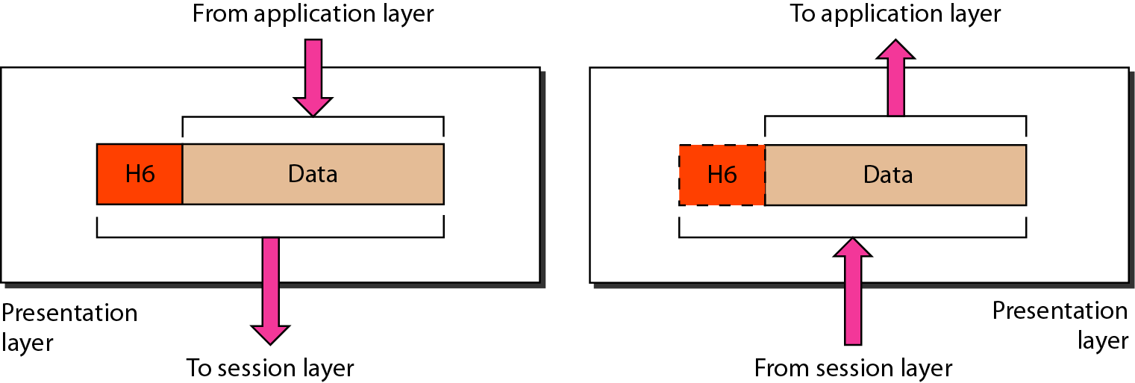
6. Presentation layer
Note
The presentation layer is responsible for translation, compression, and encryption.

Slide 23
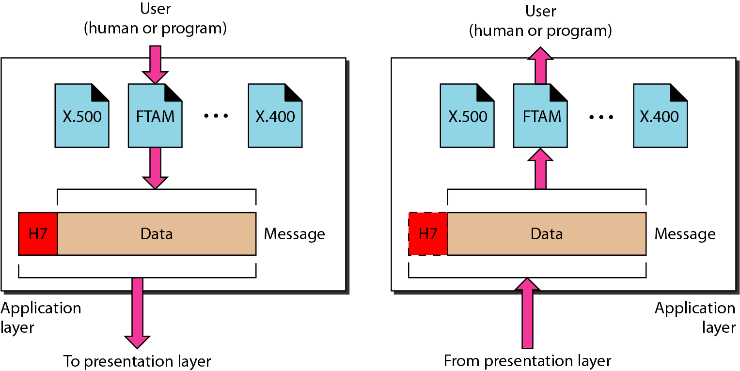
7. Application layer
Note
The application layer is responsible for providing services to the user.

Slide 24
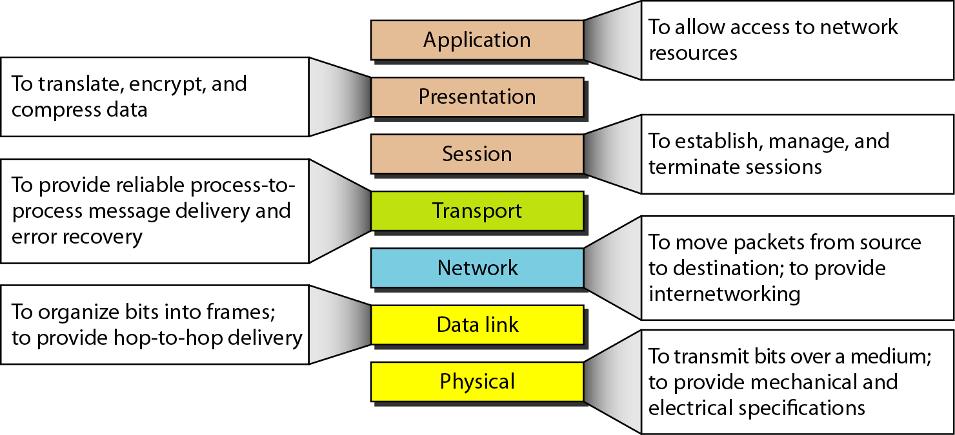
Summary of layers

Slide 25
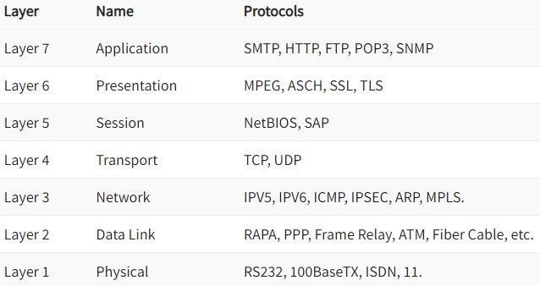
Protocol supported at various layers

Slide 26
Protocols at Application layer
TELNET: Telnet stands for the TELetype NETwork. It helps in terminal emulation. It allows Telnet clients to access the resources of the Telnet server. It is used for managing files on the internet. It is used for the initial setup of devices like switches. The telnet command is a command that uses the Telnet protocol to communicate with a remote device or system. Port number of telnet is 23.
FTP: FTP stands for file transfer protocol. It is the protocol that actually lets us transfer files. It can facilitate this between any two machines using it. But FTP is not just a protocol but it is also a program. FTP promotes sharing of files via remote computers with reliable and efficient data transfer. The Port number for FTP is 20 for data and 21 for control.

Slide 27
Protocols at Application layer
TFTP: The Trivial File Transfer Protocol (TFTP) is the stripped-down, stock version of FTP, but it’s the protocol of choice if you know exactly what you want and where to find it. It’s a technology for transferring files between network devices and is a simplified version of FTP. The Port number for TFTP is 69.

Slide 28
Continued….
SMTP: It stands for Simple Mail Transfer Protocol. It is a part of the TCP/IP protocol. Using a process called “store and forward,” SMTP moves your email on and across networks. It works closely with something called the Mail Transfer Agent (MTA) to send your communication to the right computer and email inbox. The Port number for SMTP is 25.
SNMP: It stands for Simple Network Management Protocol. It gathers data by polling the devices on the network from a management station at fixed or random intervals, requiring them to disclose certain information. It is a way that servers can share information about their current state, and also a channel through which an administrate can modify pre-defined values. The Port number of SNMP is 161(TCP) and 162(UDP).

Slide 29
Continued…
DNS: It stands for Domain Name System. Every time you use a domain name, therefore, a DNS service must translate the name into the corresponding IP address. For example, the domain name www.abc.com might translate to 198.105.232.4. The Port number for DNS is 53
DHCP: It stands for Dynamic Host Configuration Protocol (DHCP). It gives IP addresses to hosts. There is a lot of information a DHCP server can provide to a host when the host is registering for an IP address with the DHCP server. Port number for DHCP is 67, 68.

Slide 30
Presentation layer protocols
MPEG: The Moving Pictures Experts Group's standard for the compression and coding of motion video for CD's is very popular. QuickTime: This is for use with Machintosh or Power PC programs, it manages audio and video applications.
SSL (Secure Socket Layer) and TLS (Transport Layer Security) are popular cryptographic protocols that are used to imbue web communications with integrity, security, and resilience against unauthorized tampering.

Slide 31
Session layer protocols
NetBIOS is a non-routable OSI Session Layer 5 Protocol and a service that allows applications on computers to communicate with one another over a local area network (LAN). NetBIOS was developed in 1983 by Sytek Inc. as an API for software communication over IBM PC Network LAN technology.
SAP: The protocol used by SAP programs that communicate using the NI interface is called the SAP Protocol. This is an enhanced version of the TCP/IP protocol, which has been supplemented by one length field and some options for error information .

Slide 32
Transport layer protocol
TCP: The Transmission Control Protocol (TCP) is a transport protocol that is used on top of IP to ensure reliable transmission of packets. TCP includes mechanisms to solve many of the problems that arise from packet-based messaging, such as lost packets, out of order packets, duplicate packets, and corrupted packets.
User Datagram Protocol (UDP) – a communications protocol that facilitates the exchange of messages between computing devices in a network. It's an alternative to the transmission control protocol (TCP). In a network that uses the Internet Protocol (IP), it is sometimes referred to as UDP/IP.

Slide 33
Internet protocol
IPV6: Internet Protocol version 6 is the most recent version of the Internet Protocol, the communications protocol that provides an identification and location system for computers on networks and routes traffic across the Internet.
ICMP: ICMP is a network level protocol. ICMP messages communicate information about network connectivity issues back to the source of the compromised transmission. It sends control messages such as destination network unreachable, source route failed, and source quench.
MPLS: Multiprotocol Label Switching, or MPLS, is a networking technology that routes traffic using the shortest path based on “labels,” rather than network addresses, to handle forwarding over private wide area networks.
ARP: ARP is the protocol used to associate the IP address to a MAC address. When a host wants to send a packet to another host, say IP address 10.5. 5.1, on its local area network (LAN), it first sends out (broadcasts) an ARP packet.

Slide 34
Data link layer
PPP: In computer networking, Point-to-Point Protocol is a data link layer communication protocol between two routers directly without any host or any other networking in between. It can provide connection authentication, transmission encryption, and data compression.
ATM: ATM is a core protocol used in the SONET/SDH backbone of the public switched telephone network (PSTN) and in the Integrated Services Digital Network (ISDN), but has largely been superseded in favor of next-generation networks based on Internet Protocol (IP) technology

Slide 35
Physical layer
ISDN: ISDN or Integrated Services Digital Network is a circuit-switched telephone network system that transmits both data and voice over a digital line. You can also think of it as a set of communication standards to transmit data, voice, and signaling. These digital lines could be copper lines.
100Base-TX: 100Base-TX is an Ethernet networking standard (IEEE 802.3u standard.) that supports up to 100 Mbps transfer speed. 100Base-TX was also called as FastEthernet, because Ethernet was 10 Mbps that time and FastEthernet was faster than Ethernet.

Slide 36
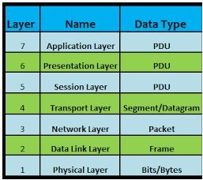
PDU (Protocol Data Unit)

Slide 37
Thank You

Slide 38
Break Time

